Slide 1
NHACS SOFTBALL
2023 Season Information

Slide 2
TEAM CALENDAR
SEASON STARTS April 19TH
8 GAME REGULAR SEASON
TOP 4 TEAMS IN DIVISION A MAKE PLAYOFFS SEASON WILL PROBABLY EXTEND INTO JUNE
SEASON WILL NOT INTERFERE WITH PROM/SENIOR TRIP

Slide 3
REQUIRED EQUIPMENT
SOFTBALL GLOVE (11.5 INCH MINIMUM)
SOFTBALL CLEATS (PLASTIC)
SNEAKERS FOR TURF GAMES
T-SHIRTS (NO PRACTICING IN VISIBLE SPORTS BRAS)
BATS (OPTIONAL)
MUST BE A SOFTBALL BAT NOT A BASEBALL BAT
WATER (OPTIONAL)
TEAM PANTS (BLACK)

Slide 4
8 GAME SEASON PLUS PLAYOFFS –
WEEKDAY GAMES GENERALLY START AT 4:15 PM
MUST COME TO SCHOOL IN ORDER TO PRACTICE OR PLAY IN GAME
ALWAYS BRING YOUR GLOVE AND CLEATS TO PRACTICE
TEAM EXPECTATIONS

Slide 5
Be RESPECTFUL to all coaches, umpires, opponents and each other at all times. Remember that you are representing New Heights, the coaches, and your families at all times!
No profanity or inappropriate language.
All lateness and absences from practices or games must be communicated PERSONALLY or by a PARENT to the coach via word of mouth, text or email. NO explanations for absences are to be communicated via third parties.
No visitors are allowed at practice unless authorized by the coaches. Any visitor causing a distraction will be asked to leave.
All players will be responsible for maintaining their academic standing. Players must not have any incomplete work when grades are checked or they will be ineligible.
TEAM RULES

Slide 6
ACADEMICS
It is YOUR responsibility to hand in all of your classwork/homework on TIME!!!!
Eligibility will be determined by Mr. Sandomenico and Mr. Givens

Slide 7
DISCIPLINE
Coach K cannot intervene in school discipline
Detention
If you are late to practice because of detention, you will do extra exercises
Teacher complaints – extra laps or game suspension
Suspension
You cannot participate in practices or games if you are suspended from school
Coach K doesn’t like to be embarrassed!!!!!

Slide 8
GAME DAY
I
II
III
IV
V
MUST come to school and be ON TIME in order to play unless you are on a school authorized trip.
Team members will be excused from last two class periods on game days
Only players and managers may leave early with the team to travel to games
Players are allowed to change into their jerseys at lunchtime on game day
DO NOT assume a game will be canceled because of rain in the morning. Always come to school prepared to play

Slide 9
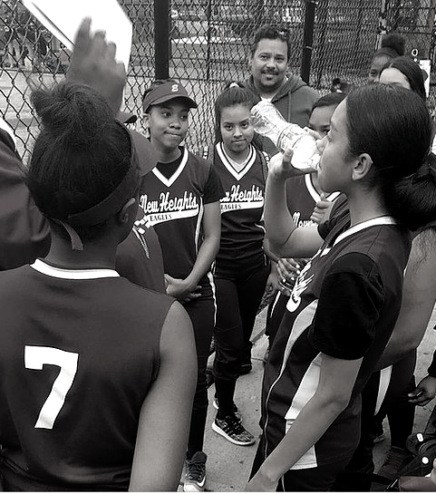
GAME DAY
VI
VII
On a rainy game day,
DO NOT call/text Coach K asking if the game is canceled!!!! It does me no good to know the game is canceled and not tell my players. If you don’t know, then I probably don’t know either.
Generally, we will meet at school for Saturday games unless you directly tell the Coach you will be arriving on your own

Slide 10
PRACTICE
Practice 2-3 times a week
Generally 2 hours long
Permits (TBD…Riverbank or Lenox)
Get changed and get to the park as soon as possible. Use bathroom before coming to practice.
Stretch and warm up
Latecomers do stretches on the side with managers before joining team activity
Bring water/Gatorade with you to practice
All absences from practice should be posted in team app and texted to Coach K directly.
Inform team Administrator of all lateness and absences from practice in addition to Coach K
Do not bring visitors/guests to practice without Coach K’s permission

Slide 11
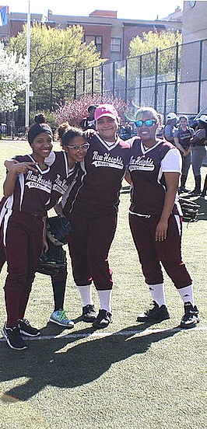
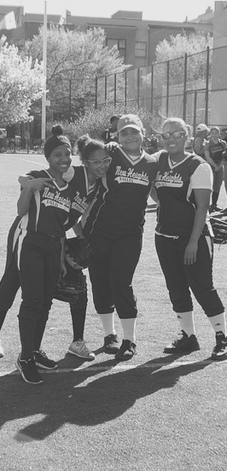
TEAM GOALS
FINISH IN 1ST PLACE
WIN THE CSSA CHAMPIONSHIP
2022
6-3 RECORD
Made playoffs 8 years in a row

Slide 12
ALWAYS REMAIN CALM
COACH K'S C'S TO SUCCESS
You cannot think when you are not calm
CONCENTRATE ON WHAT YOU ARE DOING
Always think of what you are going to do ahead of time
BE CONSISTENT
Always execute your fundamentals (swing, step and throw, etc)
BE CONFIDENT
Believe in yourself and your teammates
COMMUNICATION IS
THE KEY
Talk to your teammates about game situations

Slide 13
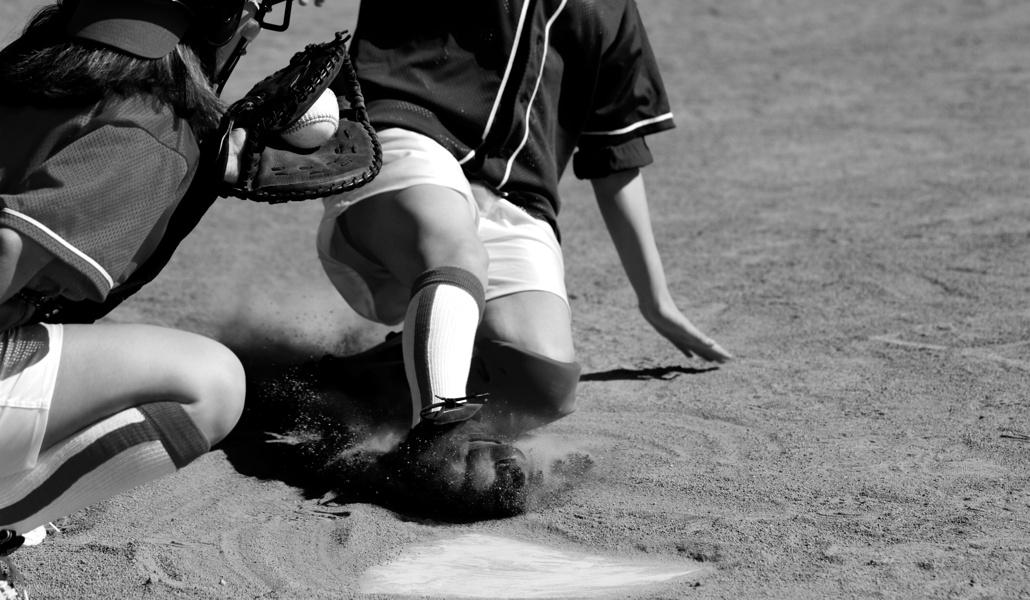
CATCH THE BALL!!!
CATCH THE BALL!!!
CATCH THE BALL!!!
CATCH THE BALL!!!
STOP BEING SCARED OF THE BALL, IT WON’T HURT/HIT YOU IF YOU CATCH IT!!!

Slide 14
3 strikes = you’re out
6 inning game = 18 outs
4 balls = walk (base on balls) - 3 outs per half inning
Away team bats first, home team bats last
CSSA Mercy Rule – If either team has a 10 run lead after 4 turns at bat, the game is over. (the team that is behind has to make 12 outs)
2 hour permit time (if a team is waiting to use the field after 2 hours, the umpire may stop game after 4 or 5 innings)
If you bunt foul with two strikes, the batter is out
If you are running to home plate and the catcher is trying to make a play, you MUST slide
GENERAL SOFTBALL BASICS

Slide 15
If there is a pop-up and the runner leaves before the ball is touched/caught, it can be thrown back to the base where the runner started for a force play out.
All other plays are tag plays, where the fielder must catch the ball and tag the runner before the runner touches the base.
4 components to softball
Fielding
Baserunning
Pitching
Hitting
GENERAL SOFTBALL BASICS

Slide 16
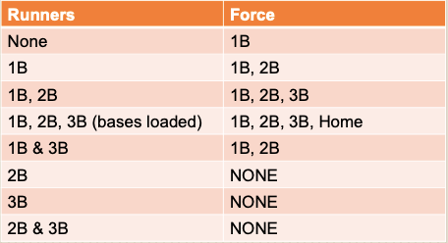
GENERAL SOFTBALL BASICS
Force play – Step on the base while holding the ball (no tag required)

Slide 17
SOFTBALL BASICS - FIELDING
THE 3 ‘B'S OF FIELDING/DEFENSE
Going for the Ball
Covering a Base
Backing up a throw/catch

Slide 18
SOFTBALL BASICS - FIELDING
Before the pitch is thrown, know what you are going to do if the ball is hit to you
Always know how many outs there are
Always be aware of the runners. Don’t assume they will stop because you have the ball
Call out where the play is going before the pitch is thrown.
Field ground balls with knees bent and glove on the ground
Field fly balls by running to the spot where the ball is going to land and catching the ball
Don’t throw the ball around. Get the ball into the infield and call time out!
All balls are live until time out is called. If the ball gets away from you, hustle after it as fast as you can.

Slide 19
SOFTBALL BASICS - FIELDING
Remember to “step and throw”. Step towards the target and release an accurate throw. Aim for the receiver’s chest
Call loudly for all pop-ups and fly balls! Yell “I got it!” loudly. In the infield the shortstop has priority, in the outfield, the center fielder has priority (if they call for it, let them catch it and move to a position to back them up in case the drop it)

Slide 20
SOFTBALL BASICS - BASERUNNING
Run hard to first base at all times (outside base)
Assume all balls are FAIR until the umpire says foul
Run through first base if the play is at first
Turn to the right after running through first base
If you get a hit, look at 1B coach when you are halfway down the line for signal on whether to go to second or stay at first
Trail runner cannot touch or pass lead runner
If a batted ball hits a runner, the runner is out unless the runner is in foul territory

Slide 21
SOFTBALL BASICS - BASERUNNING
Pay attention to the verbal and hand instructions of the 1st base and 3rd base coaches!
“Back” – back to the base
“Go” – run to the next base
“Half” – Go half way in case the ball is dropped, but be prepared to go back in case it is caught
Hands up – Stop!
Winding arms – Go!
Waving arms downward – Slide! (feet first only!)

Slide 22
SOFTBALL BASICS - BASERUNNING
Only take lead after ball is released by pitcher (strictly enforced)
Stealing is allowed after pitcher releases ball, ball gets away from catcher, or pitcher drops return throw
Look at Coach for bunt sign to know if batter is bunting
You MUST slide at bases to avoid collisions with the fielders (except diving back to first)

Slide 23
SOFTBALL BASICS - BASERUNNING
For balls hit in the air (and there are less than 2 outs), DO NOT ATTEMPT to run to the next base until the fielder touches it (or you are ABSOLUTELY sure the fielder is not going to catch it.) Your foot must be on the base when the fielder touches the ball in order to advance to the next base
Run on ANY ball that is hit when there are two outs.
If a thrown ball hits a runner, the ball is live and must be retrieved by the fielders
If a batted ball hits a runner, the runner is out unless the runner is in foul territory

Slide 24
SOFTBALL BASICS - PITCHING
Pitcher is allowed to take ONE step off the pitching rubber
Pitcher cannot pause once they start their motion if there are runners on base
Balk = Each runner moves up one base
Throw strikes! Stay ahead in the count
Limit walks (walks = runs)
Communicate with catcher when runners are on base (throw through, cutoff, etc)

Slide 25
SOFTBALL BASICS - HITTING
DO NOT THROW THE BAT!!!
Batter is automatically out
Strike zone is from chest to knees and over the plate. (adjust to umpire)
Don’t lunge or reach to swing high, low, or outside
Don’t swing at a 3-0 pitch unless instructed to by Coach. Make the pitcher throw you a strike!

Slide 26
SOFTBALL BASICS - HITTING
No backtalk to the umpire!
The Count: Current balls and strikes status (balls are always listed first)
0-1, 0-2
1-0, 1-1, 1-2
2-0, 2-1, 2-2
3-0, 3-1, 3-2
Hitter’s Count??
Pitcher's Count
Goal:
Hit the ball HARD
somewhere

Slide 27
SOFTBALL BASICS - HITTING
Look towards Coach before at bat for bunt sign
Keep your eye on the ball when swinging
Be patient, get into hitters counts. 2-0, 3-1
Do not swing at 3-0 pitch unless told to by Coach
DO NOT THROW THE BAT!!!
DO NOT THROW THE BAT!!!
DO NOT THROW THE BAT!!!

